Slide 1
Patient and Public Involvement
Wellbeing
Presenter: Debbie Parkinson, PPI Lead, Innovation Agency
PPI Officer: Dave Dewhurst
@InnovationNWC

Slide 2
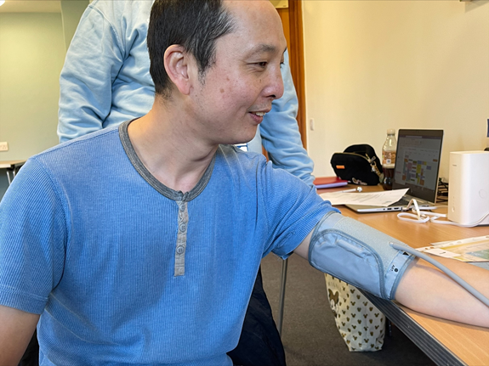
The Innovation Agency
Cardiovascular Disease
The Innovation Agency is delivering local projects to reduce hypertension and encourage home blood pressure monitoring, supporting nationally driven initiatives to encourage patients to remotely monitor their blood pressure.
Do you have a monitor at home?

Slide 3
Atrial Fibrillation (AF)
Atrial fibrillation (AF) is responsible for approximately 20 per cent of all strokes, which can leave survivors with devastating disabilities. Since 2015 we have contributed to the avoidance of 715 strokes, including 179 deaths avoided and savings of £16M to health and social care. The reduction in strokes is expected to continue, as a result of actions taken to identify people at risk and prescribe life-saving medication.

Slide 4
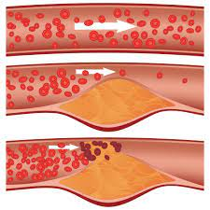
Lipids and cholesterol management
A key part of our work until 2023 will be improving the management of cholesterol. Good management of cholesterol is important in preventing heart attacks and strokes, but patients with high cholesterol are likely to be asymptomatic
We are supporting national ambitions to improve cholesterol management and the identification and management of familial hypercholesterolemia (FH), a hereditary condition of high cholesterol that is evident from birth but is rarely picked up before the individual has a CVD event.

Slide 5
Inclisiran
Inclisiran is a drug that can be used to lower ‘bad’ cholesterol (LDL) in the blood. It has been approved by drug watchdog NICE after trials showed treatment with inclisiran cuts levels of bad cholesterol by around 50 per cent.
NHS England says that, by lowering levels of bad cholesterol, inclisiran could prevent 55,000 heart attacks and strokes, with the potential to save 30,000 lives within the next 10 years
#Knowyournumbers

Slide 6
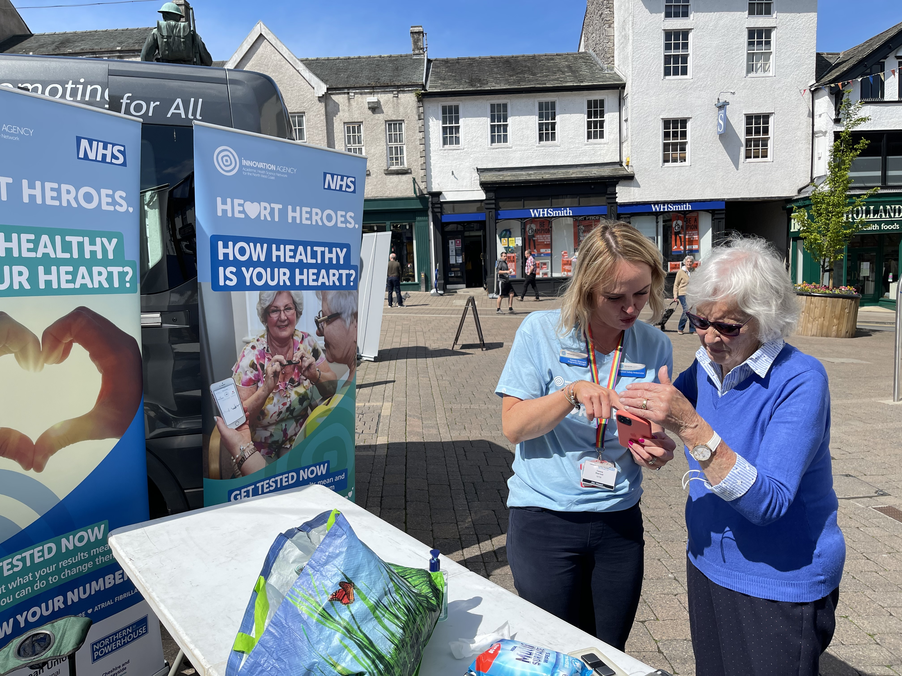
Patient and Public Involvement
AF Ambassadors and Heart Heroes
Checking the rhythm of your heart can detect AF (irregular heartbeats)
Checking blood pressure can detect problems early and you can change your lifestyle

Slide 7
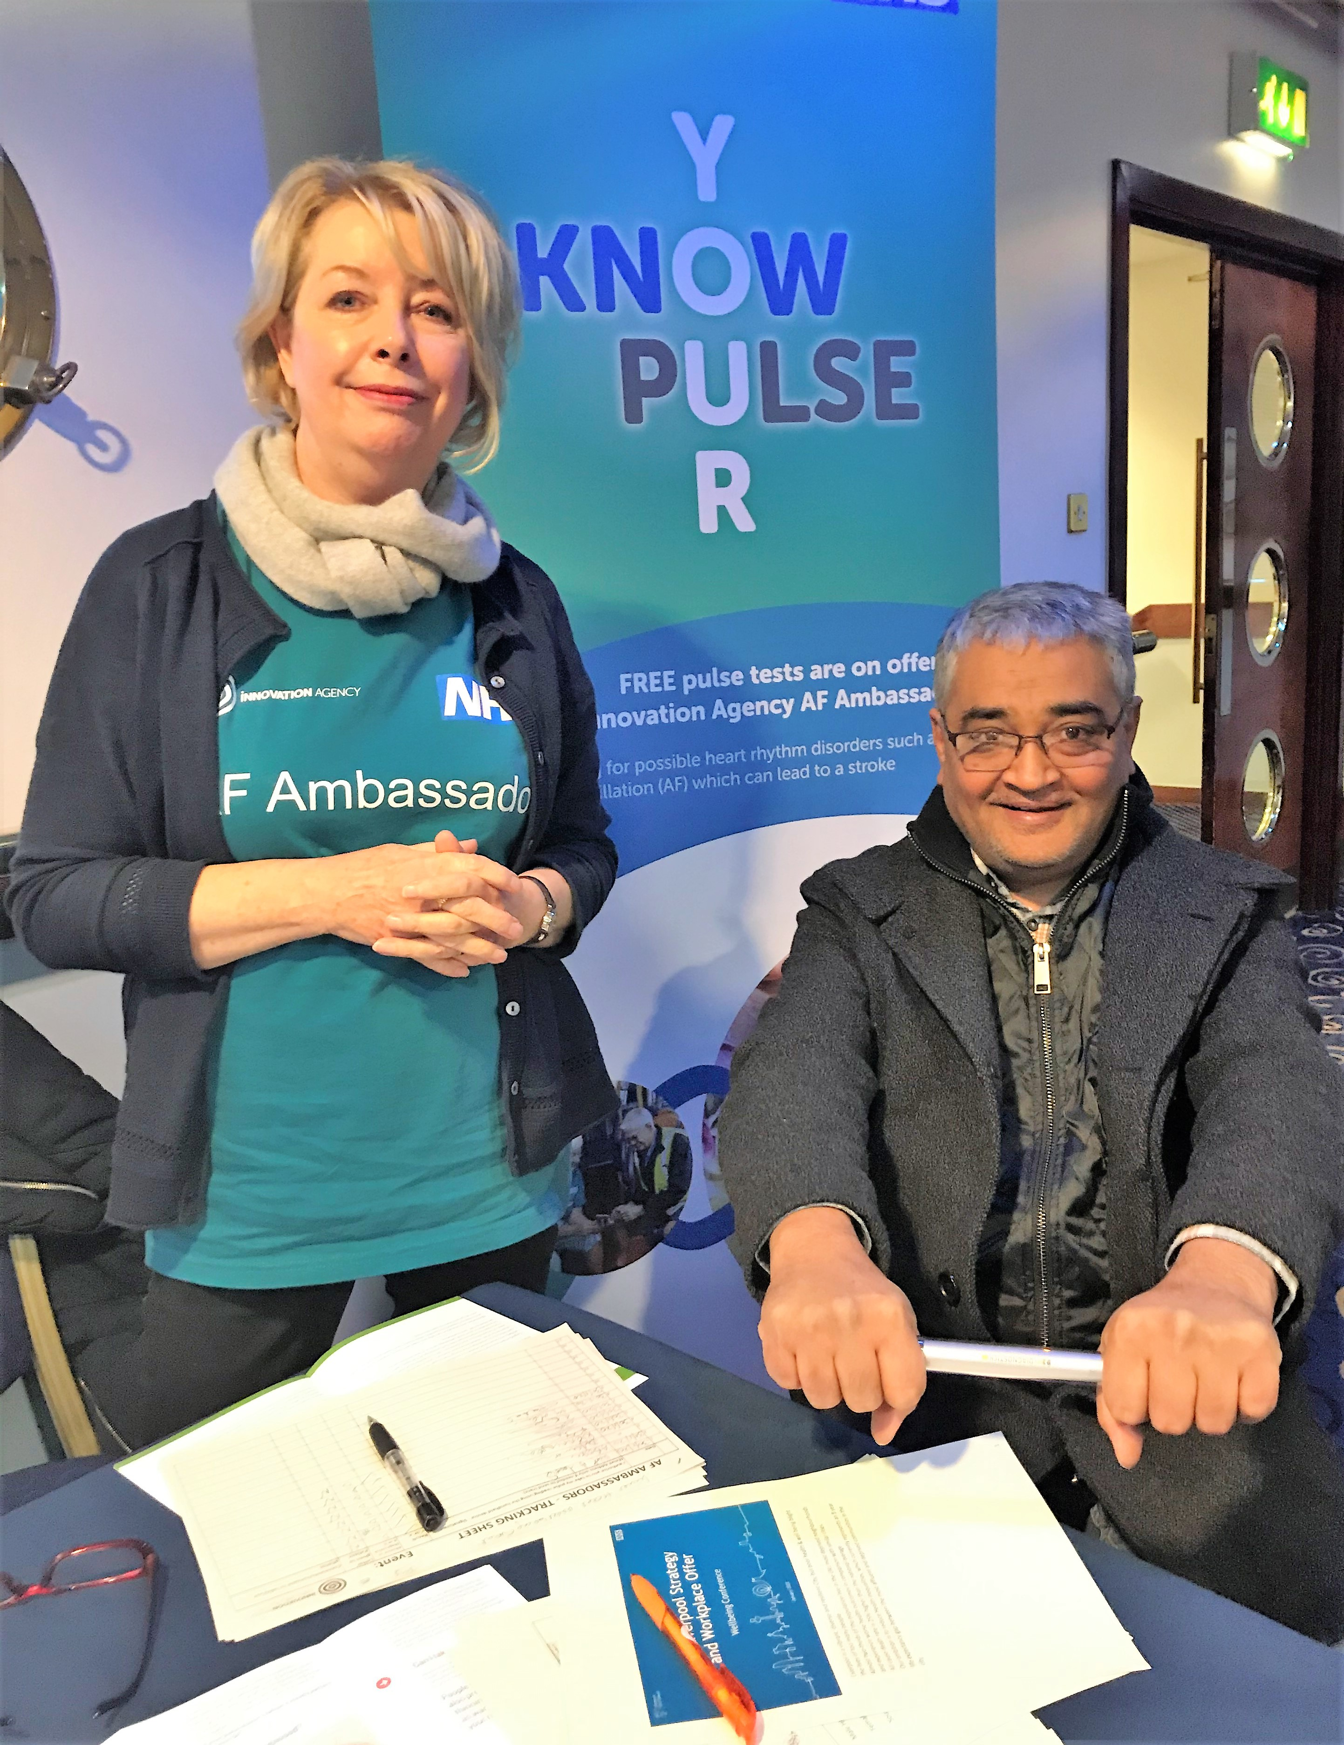
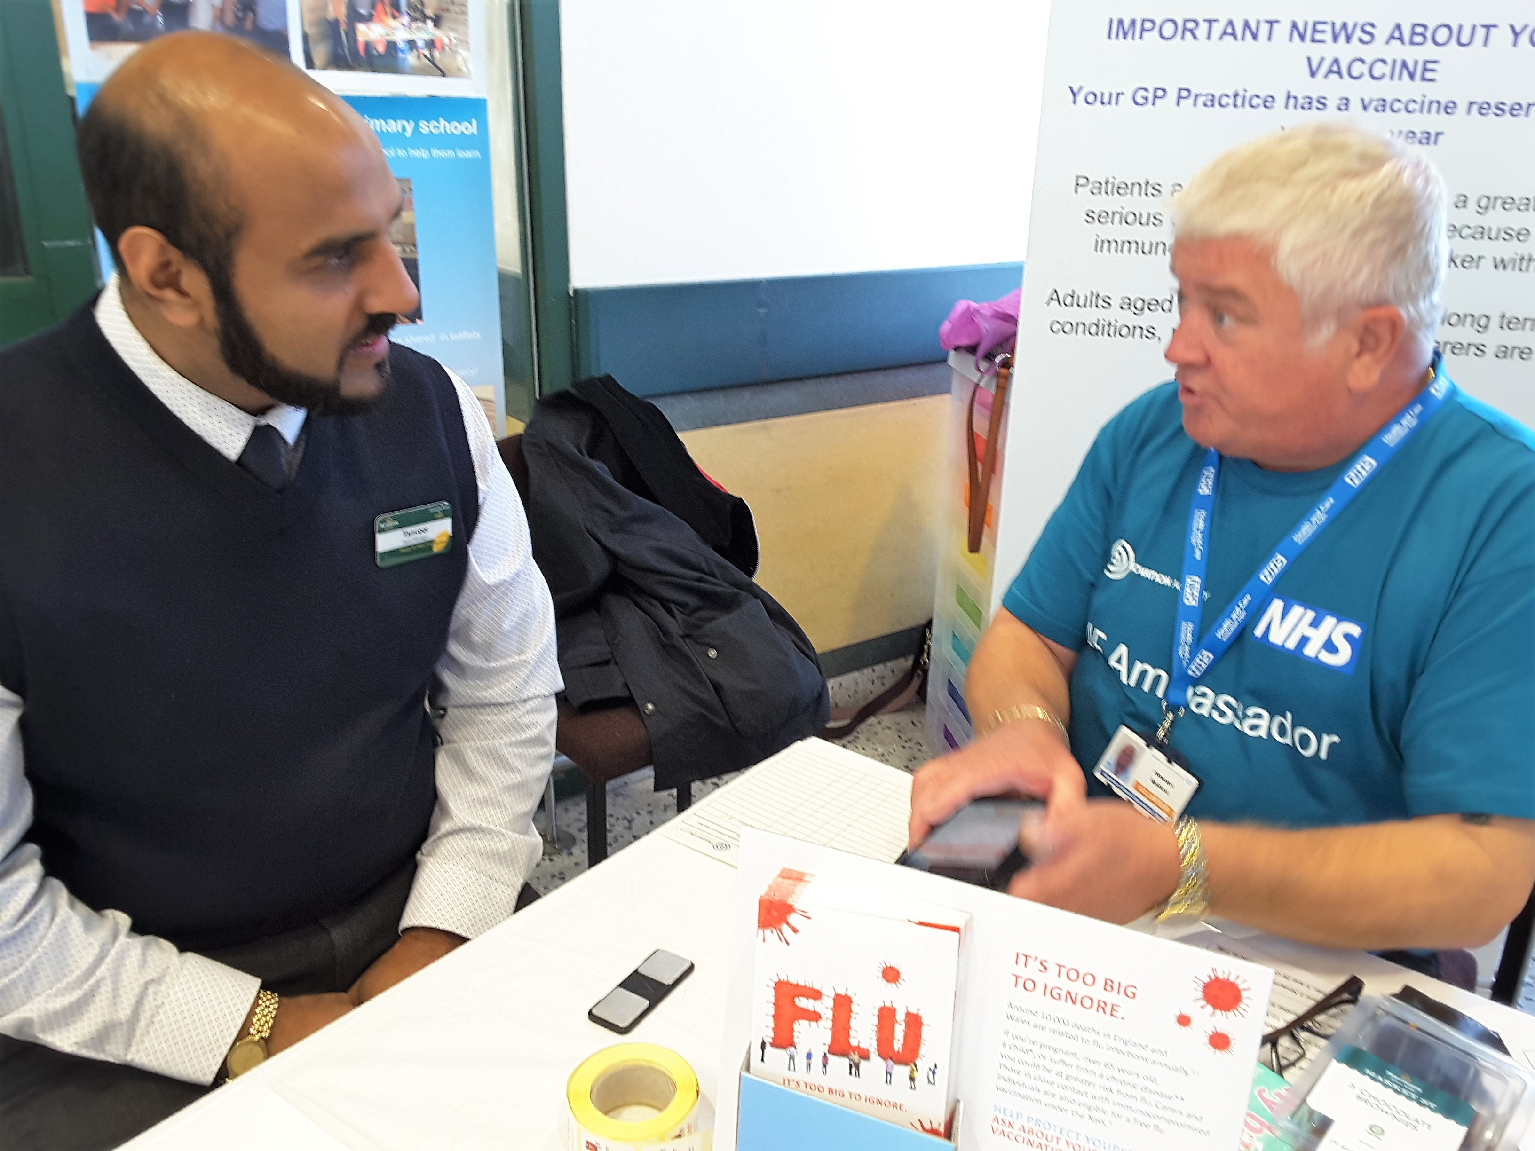
Community involvement
Some events attended by AF Ambassadors from across the NW Coast Region
Liverpool International Tennis Tournament
U3A Ormskirk, Hoylake, Leyland, Upholland
Blackburn/Burnley Mosques
Preston Gujarati Temple
Royal Mail Depots
QVC
Stagecoach buses
Age UK Centres
Preston Health Mela
Liverpool One Shopping Centre
Westmorland Show
Chai Ladies
TUC NW Conference
Flu Clinics (soon to include Covid vaccination centres)
Everton FC Home Games
Womens Institutes
Summer Fetes
Tesco
Health Melas
ASDA
iLINKS
Ageing Well (Lancaster Town Hall)
HARRI Bus (Kendal town centre, religious venues)
Milnthorpe Farmer's Market (wellbeing event in cooperation with local NHS Services)
@InnovationNWC

Slide 8
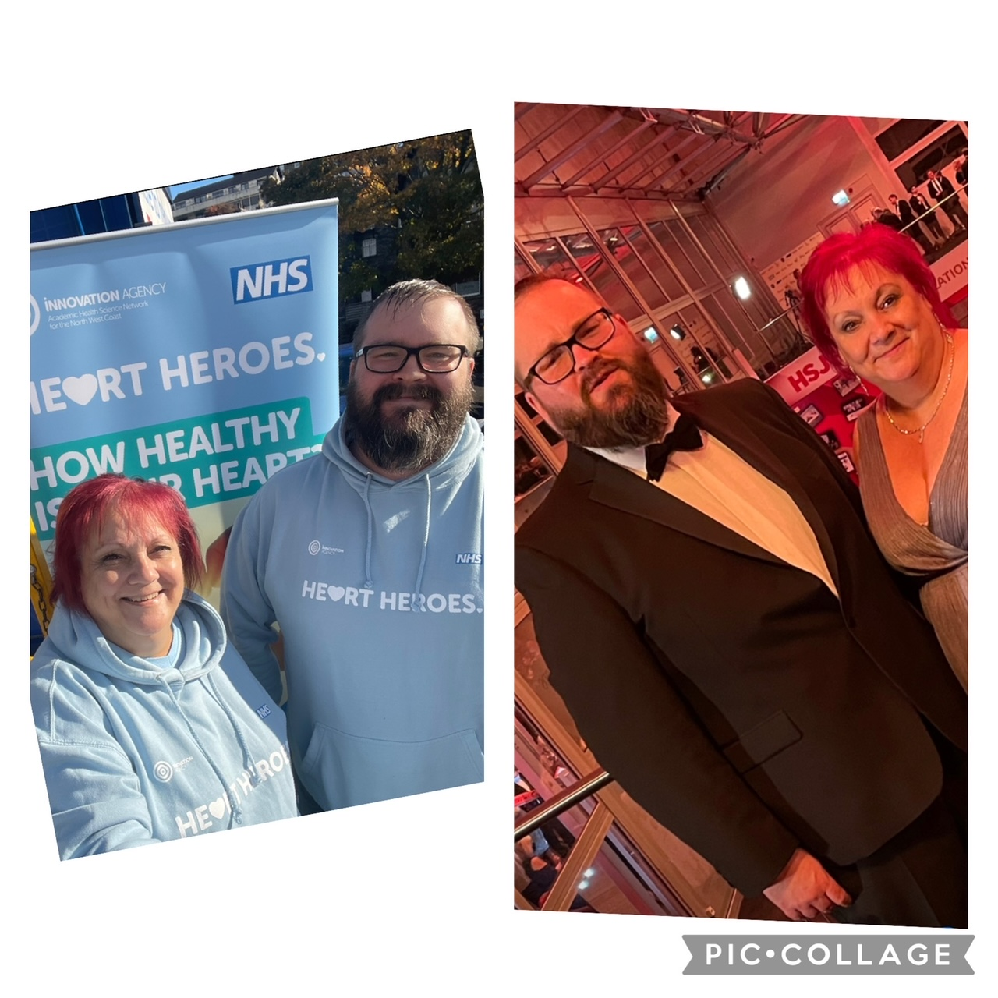
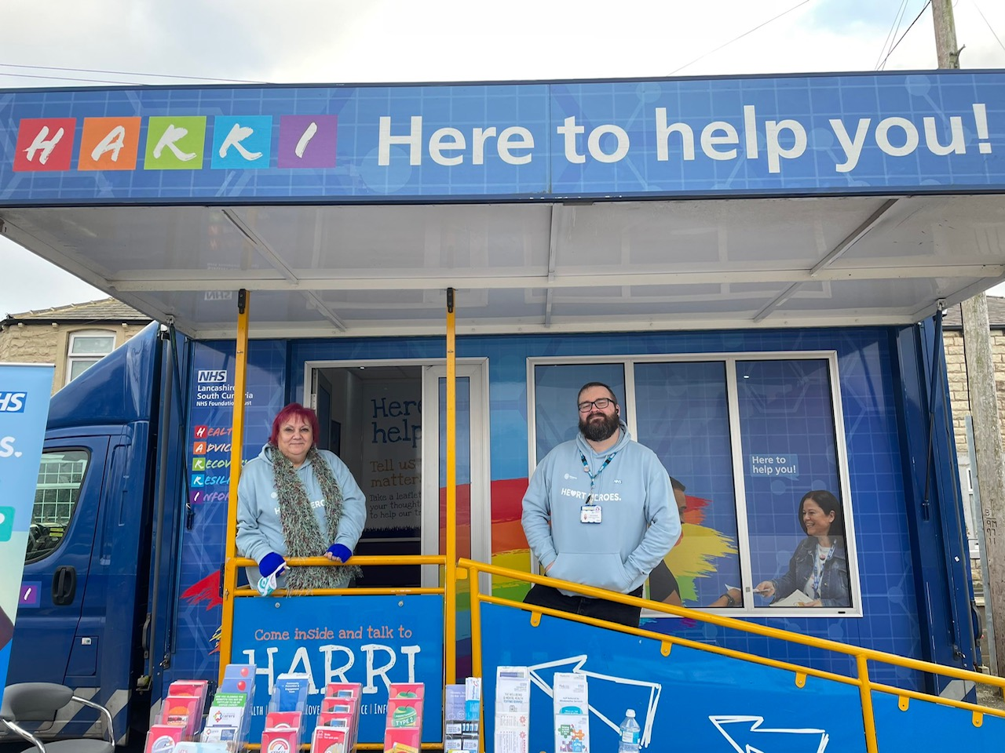
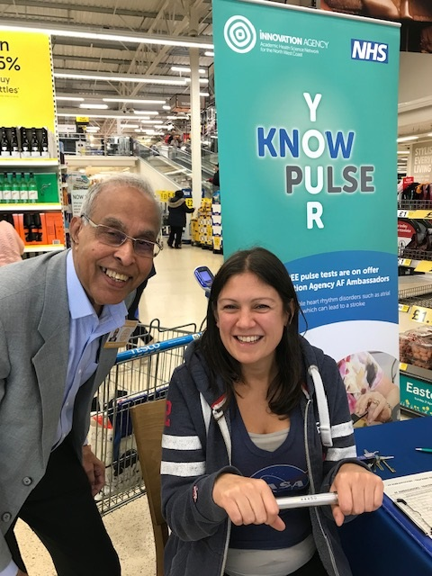
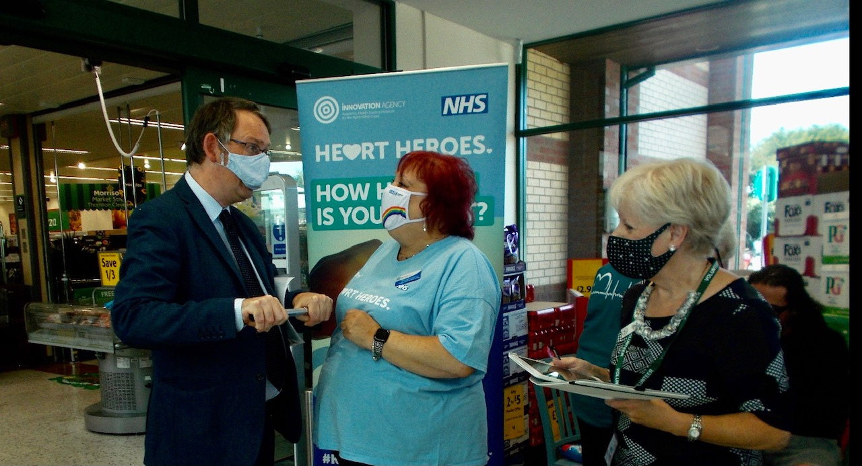
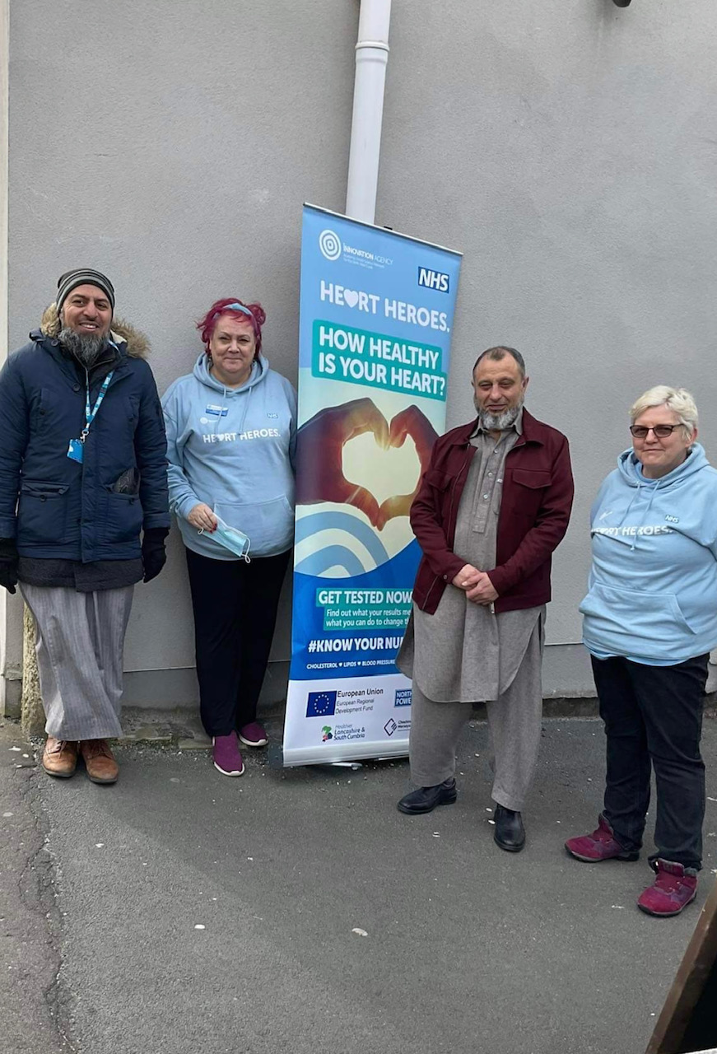
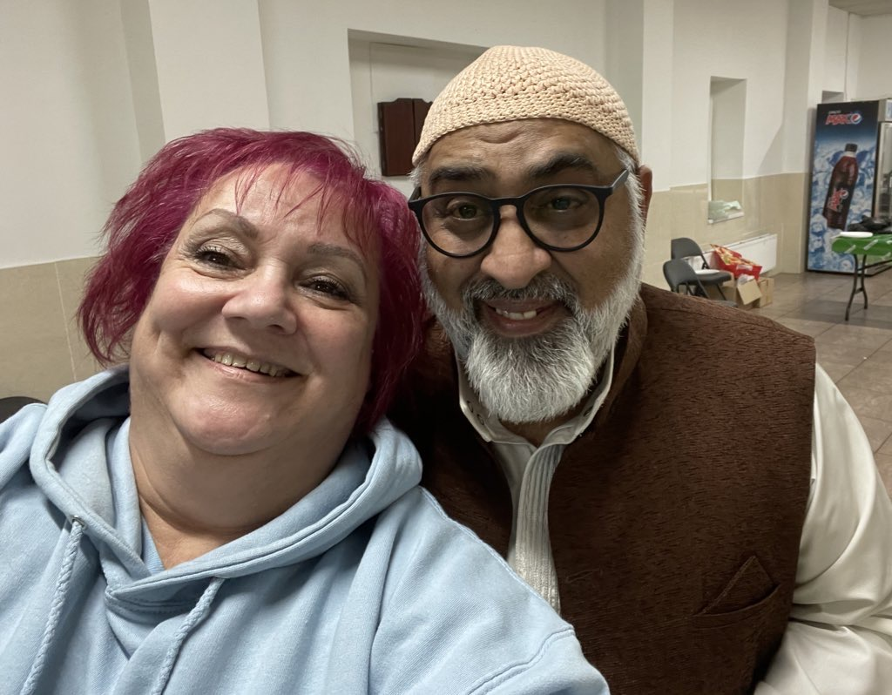
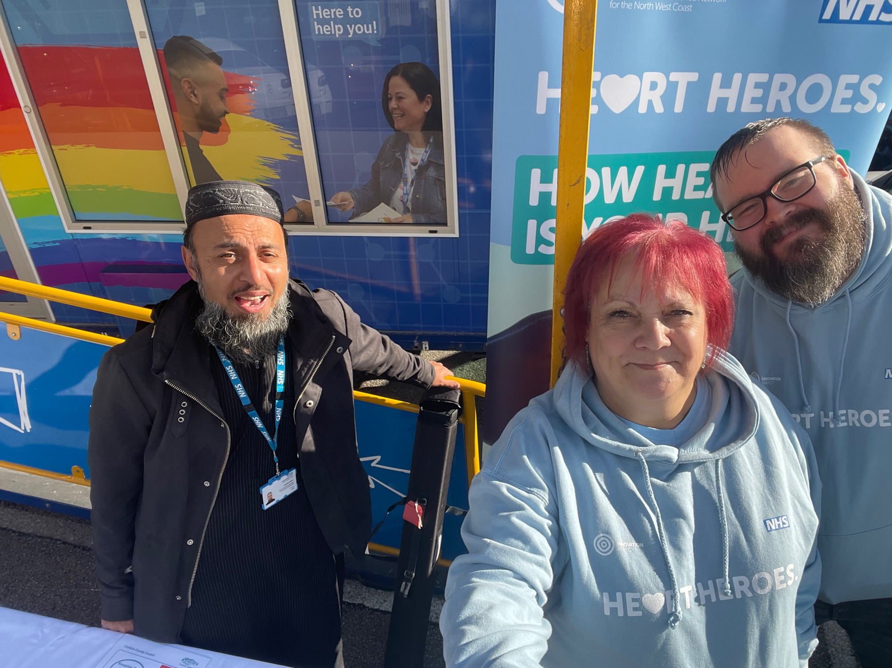
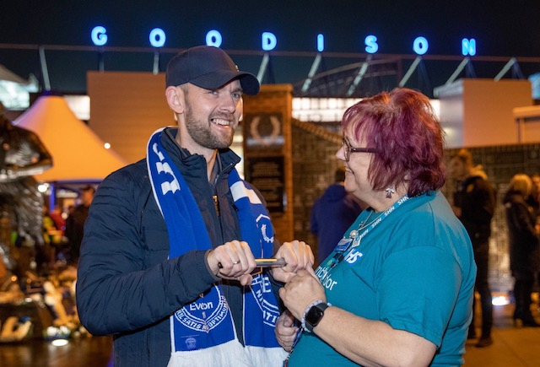
Trust
Trust
Trust
Trust

Slide 9
Financial impact with AF Ambassador contribution
Direct savings to UK plc and Integrated NHS & Social Care services in NWC
715 strokes prevented with direct saving to local NHS services: £10 million
and a saving to local Social Care services of: £6 million
536 stroke related injuries: £118 million
AF Ambassadors achieved this with an investment from NHS England of just: £20,000
Throughout the programme, the Northwest Coast has improved from 24,210 people estimated to have undetected AF to only 2,100 (data from Quality Outcomes Framework QOF) and increased high-risk AF patients on anticoagulation therapy by 8%

Slide 10
COVID - 19
COVID Oximetry @Home
The CO@H package of care involves the remote monitoring of the individual's condition through regular contact with a local health care team who will reassess the individual’s symptoms (including oxygen saturation levels). This close monitoring enables the individual to remain at home while allowing early signs of deterioration to be identified and escalated quickly and appropriately.
COVID virtual ward
The COVID virtual ward model is a secondary care-led initiative to support early and safe discharge for patients.
The key difference between the COVID virtual ward and COVID Oximetry @Home is the former provides enhanced remote monitoring, with daily calls and hospital treatments for patients

Slide 11
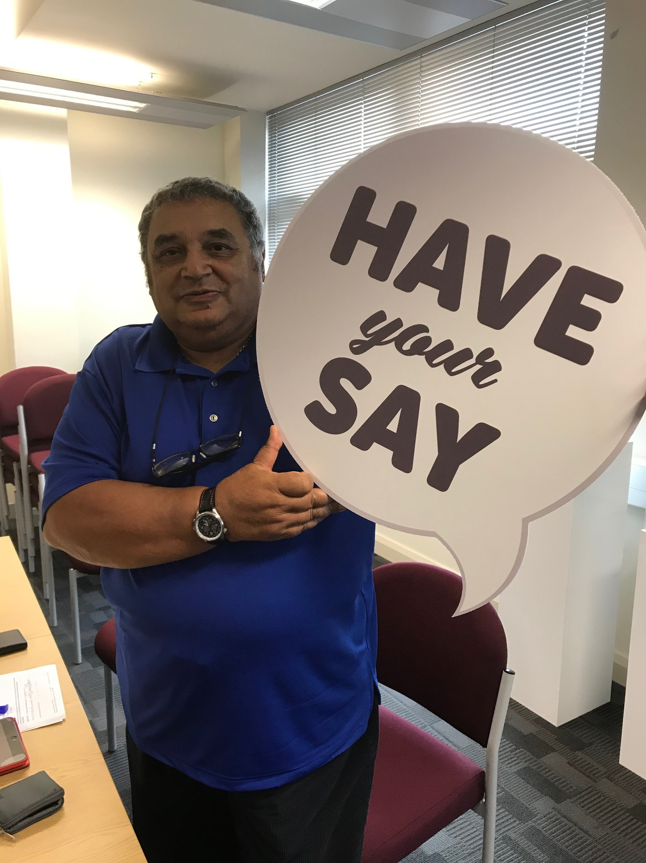
How can you be involved?
Patient and Public Involvement Senate (PIES)
Patient Safety Ambassadors Senate (PaSTIES)
Join your Patient Participation Group (PPG)
Keep in touch and help trial new innovations and systems
Check your pulse and blood pressure at home

